Slide 1
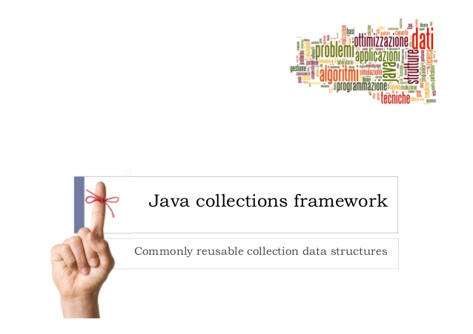
exceptions

Slide 2
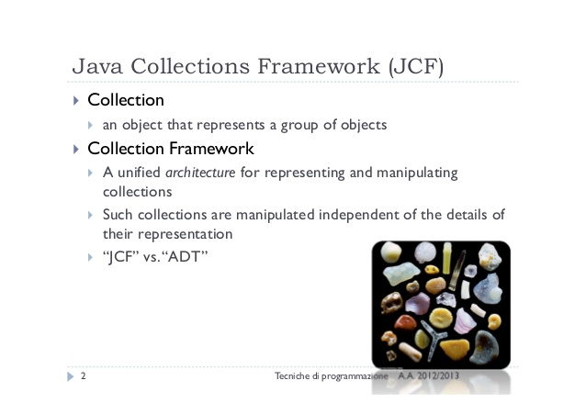
exceptions

Slide 3
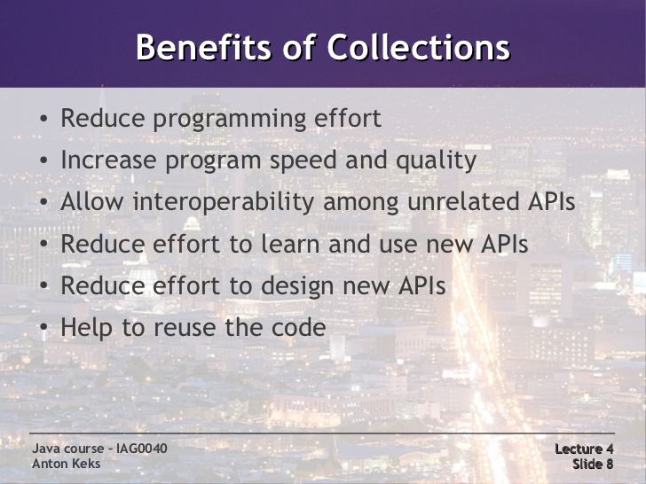
exceptions

Slide 4
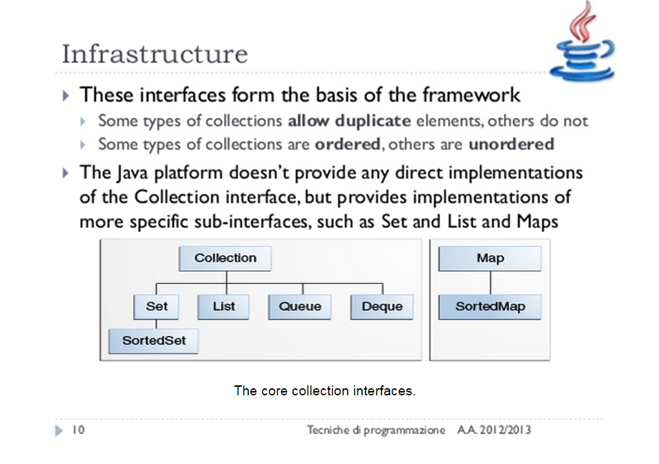
exceptions

Slide 5
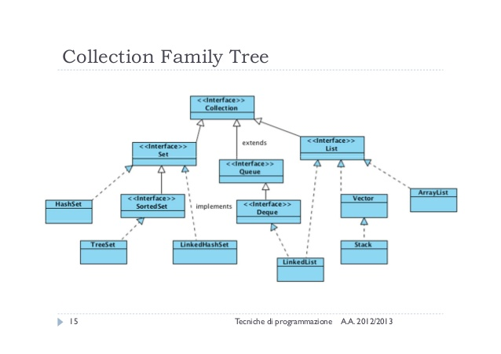
exceptions

Slide 6
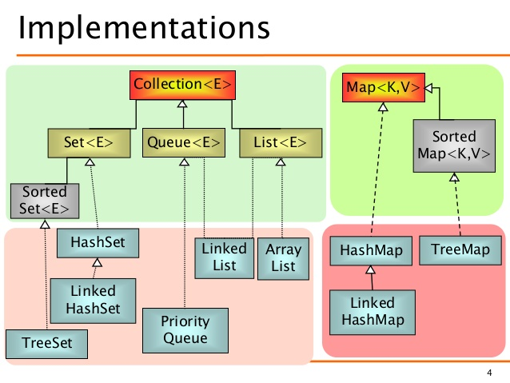
exceptions

Slide 7
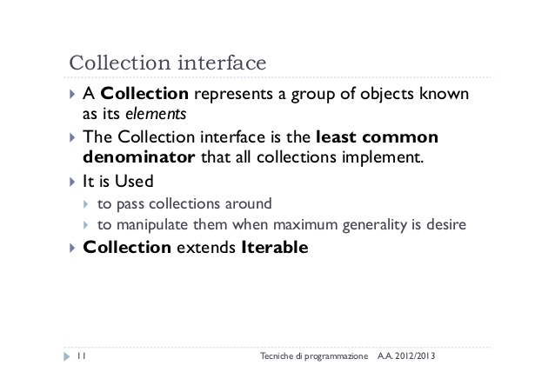
exceptions

Slide 8
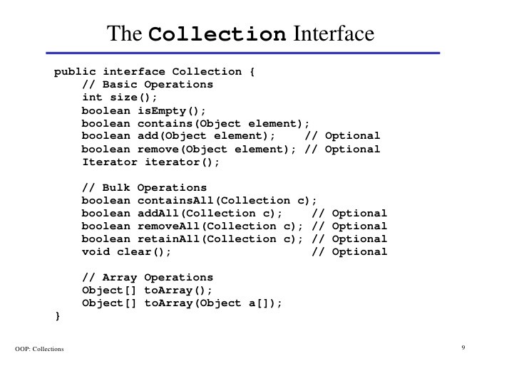
inheritance

Slide 9
inheritance
Traversing Collections
Using for-each construct:
class ForDemo {
public static void main(String[] args){
for(int i=1; i<11; i++){
System.out.println("Count is: " + i);
}
}
}
Using Iterators
static void filter(Collection<?> c) {
for (Iterator<?> it = c.iterator(); it.hasNext(); )
if (!cond(it.next()))
it.remove();
}
Enhanced for loop
class ForDemo {
public static void main(String[] args){
for(int i;args){
System.out.println("Count is: " + i);
}
}
}
Aggregate Operations
myShapesCollection.stream()
.filter(e -> e.getColor() == Color.RED)
.forEach(e -> System.out.println(e.getName()));

Slide 10
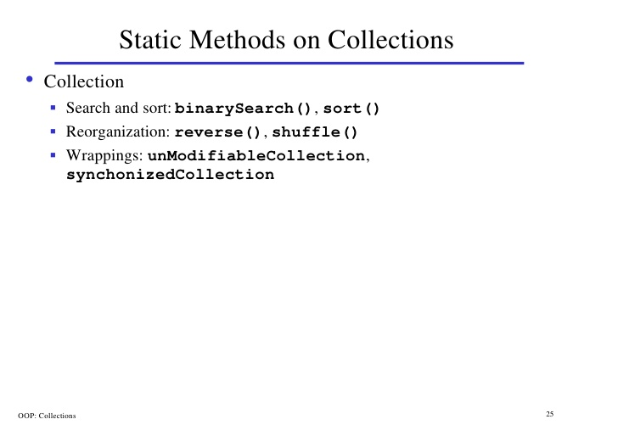
inheritance

Slide 11
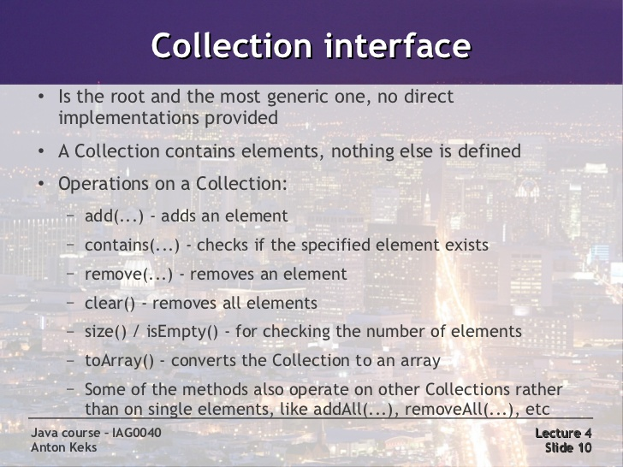
exceptions

Slide 12
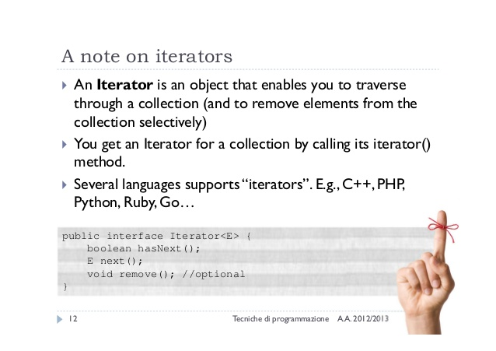
exceptions

Slide 13
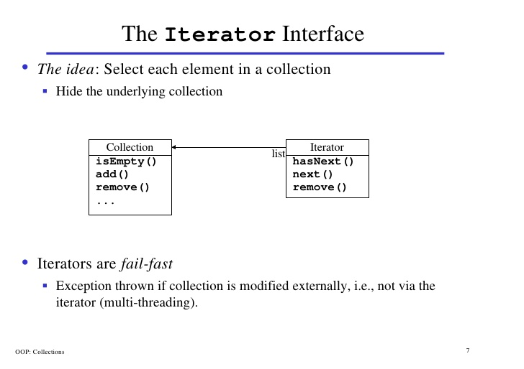
inheritance

Slide 14
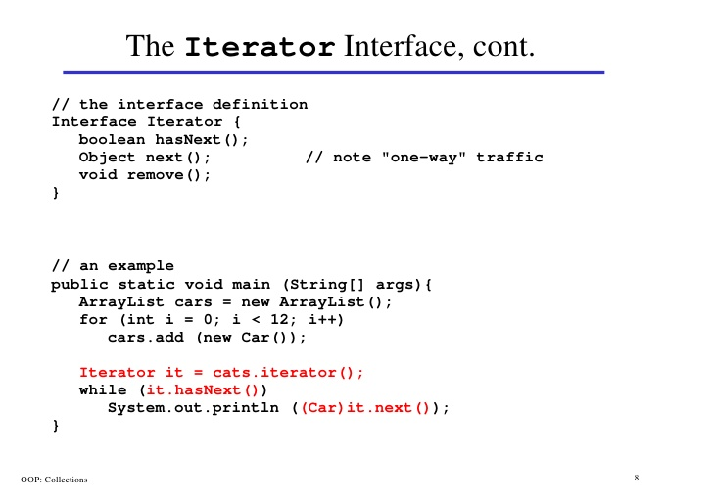
inheritance

Slide 15
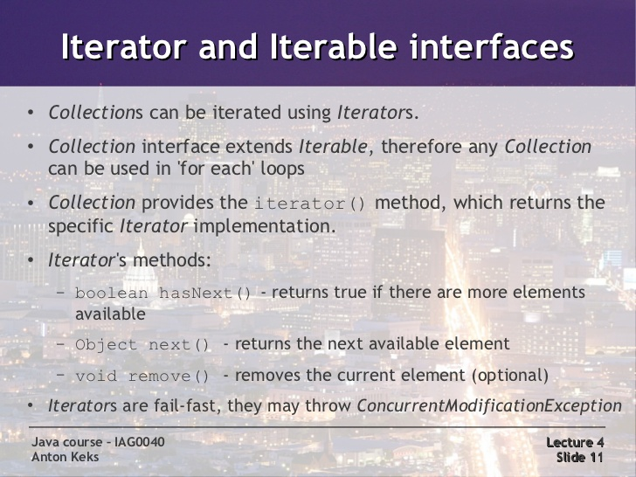
exceptions

Slide 16
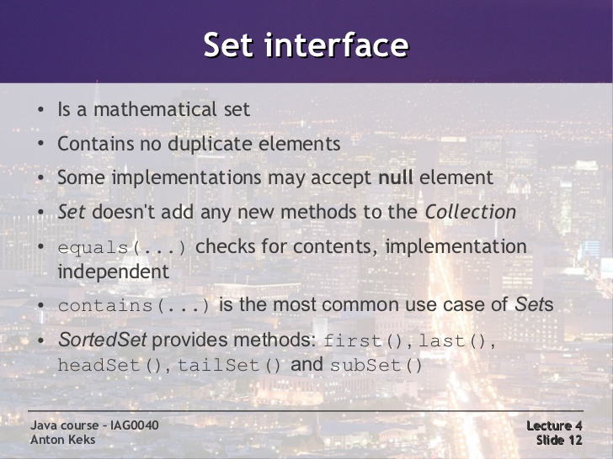
exceptions
Lab15.1: Demonstration of traversing through sets.
Lab15.2: Demonstration of traversing through sets using iterator
Lab15.3: Demonstration of traversing through sets:

Slide 17
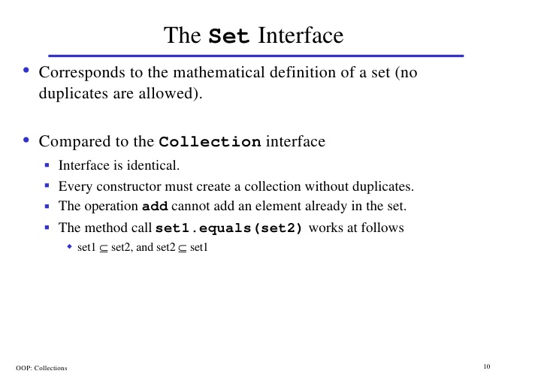
inheritance

Slide 18
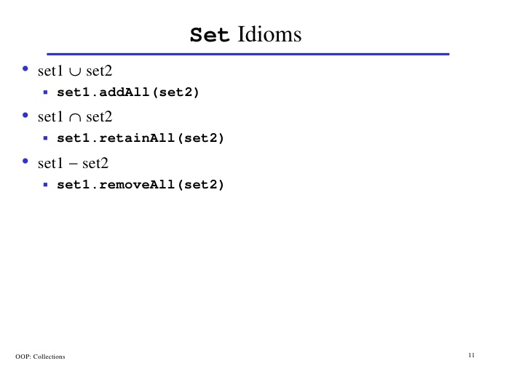
inheritance

Slide 19
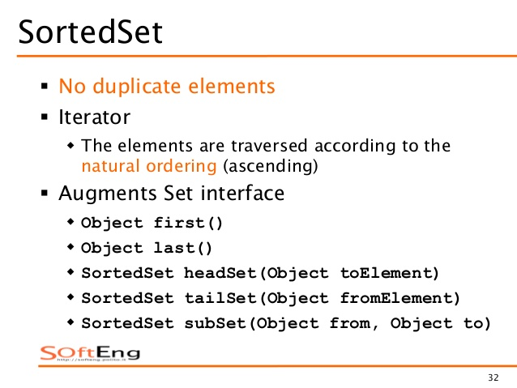
inheritance

Slide 20
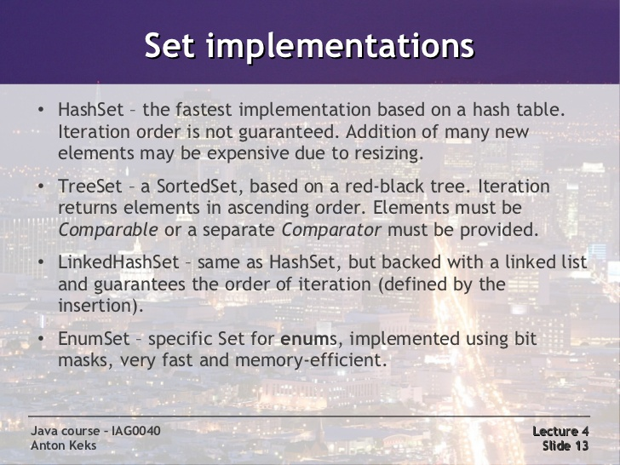
exceptions

Slide 21
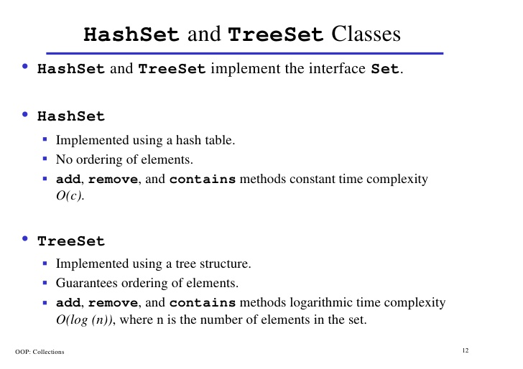
inheritance

Slide 22
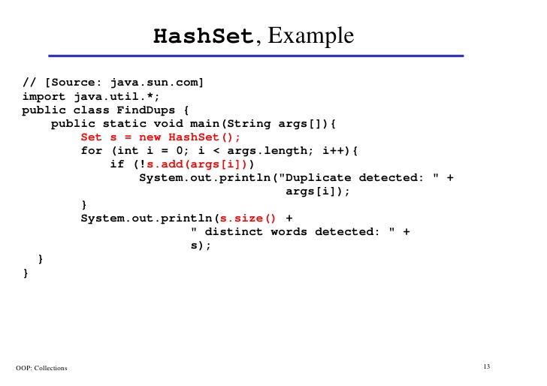
inheritance

Slide 23
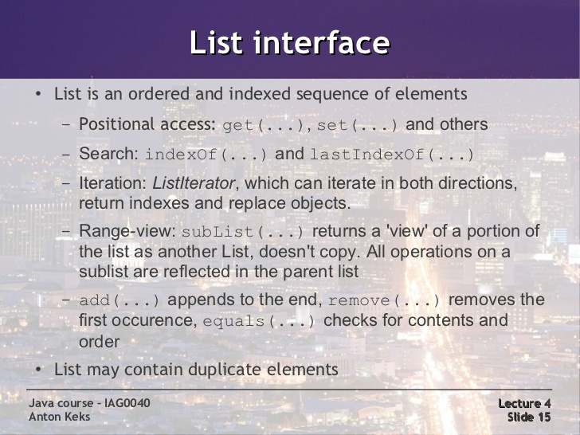
exceptions
Lab15.4: Demonstration of traversing through list:

Slide 24
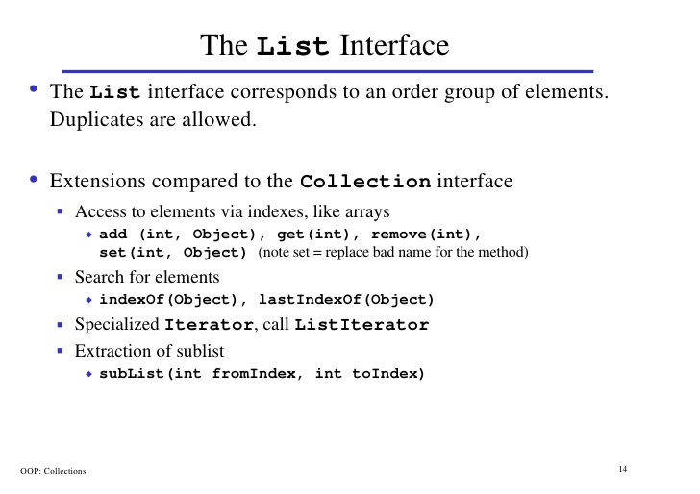
inheritance

Slide 25
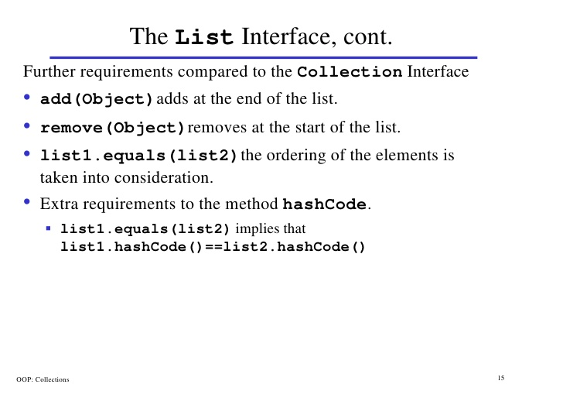
inheritance

Slide 26
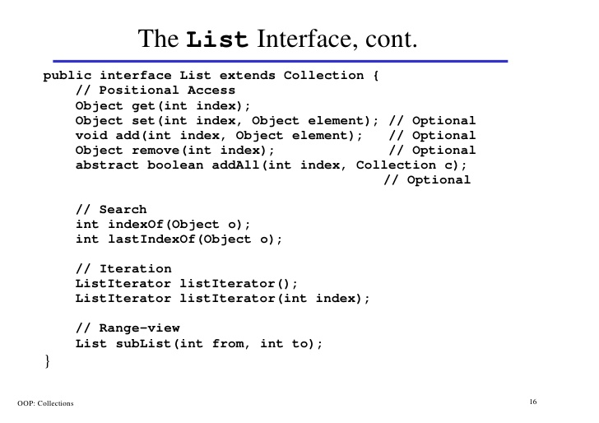
inheritance

Slide 27
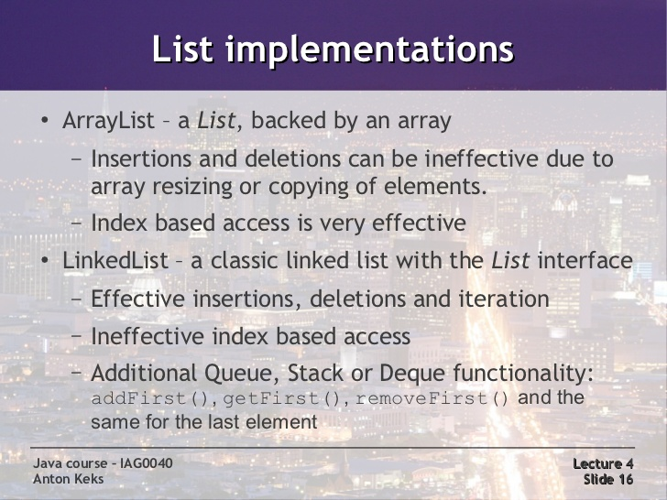
exceptions

Slide 28
inheritance
Collections API
This class consists exclusively of static methods that operate on or return collections. It contains polymorphic algorithms that operate on collections

Slide 29
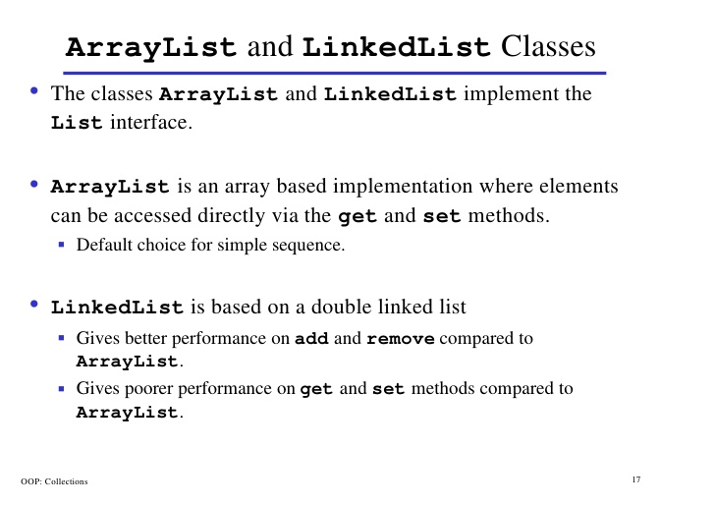
inheritance
Lab15.5: Demonstration of working with List using card game:

Slide 30
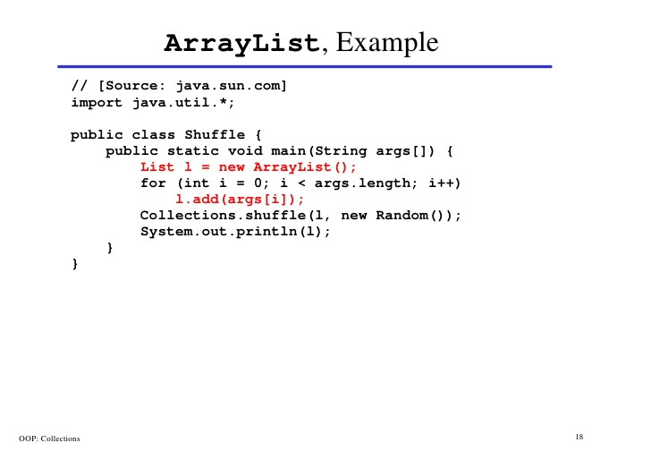
inheritance

Slide 31
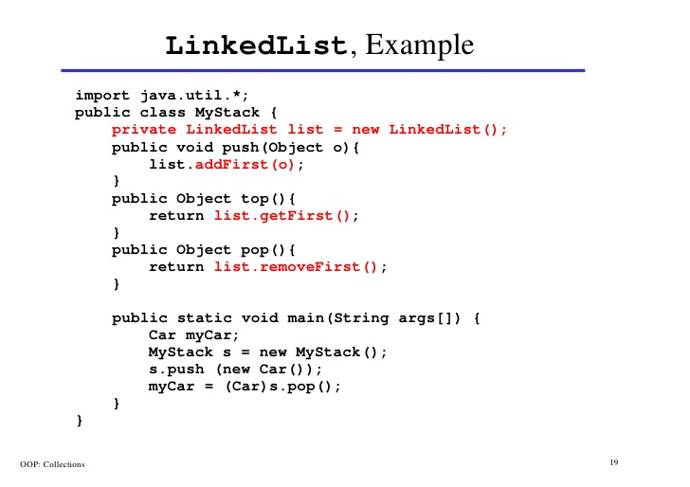
inheritance

Slide 32
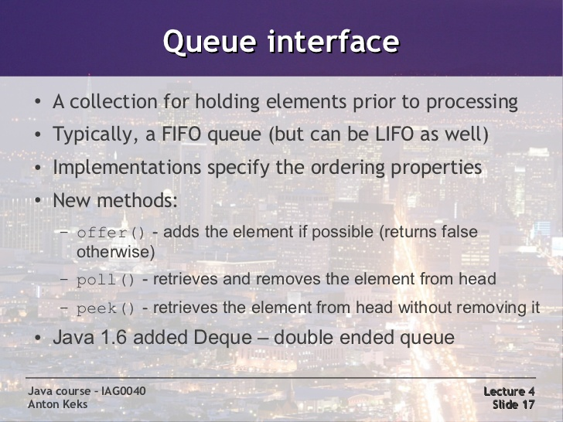
exceptions

Slide 33
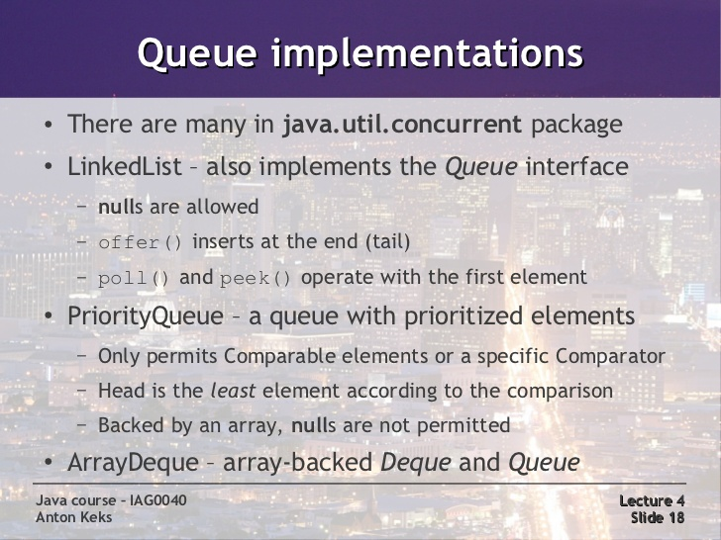
exceptions
Lab15.6: Demonstration of working with Queue with countdown example

Slide 34
exceptions
Deque
linear collection of elements that supports the insertion and removal of elements at both end points.
Defines methods for accessing the elements from both ends of the queue.
Implementations: ArrayDeque and LinkedList

Slide 35
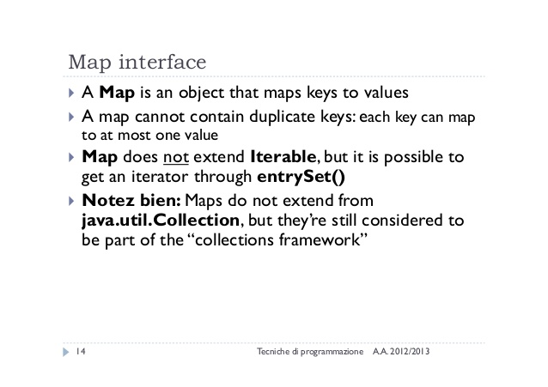
exceptions

Slide 36
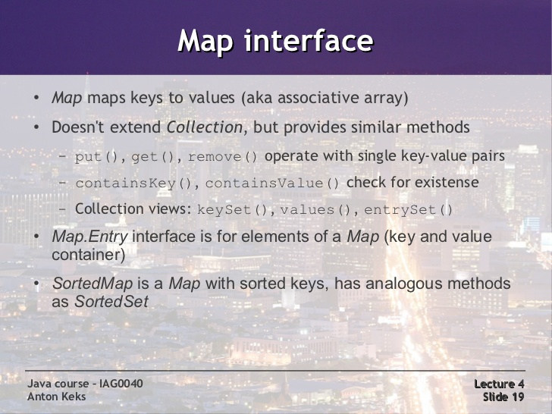
exceptions
Lab15.7: Demonstration of working with Maps:

Slide 37
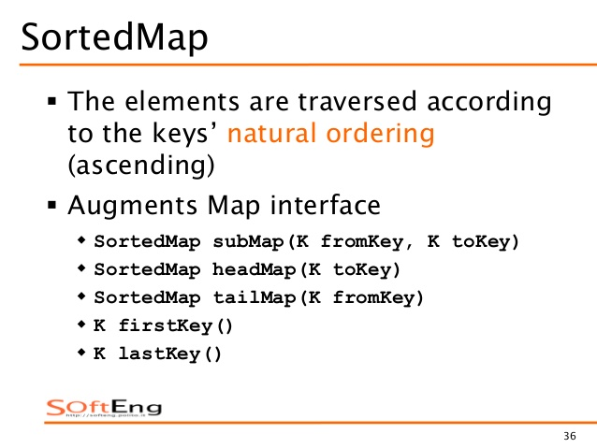
exceptions

Slide 38
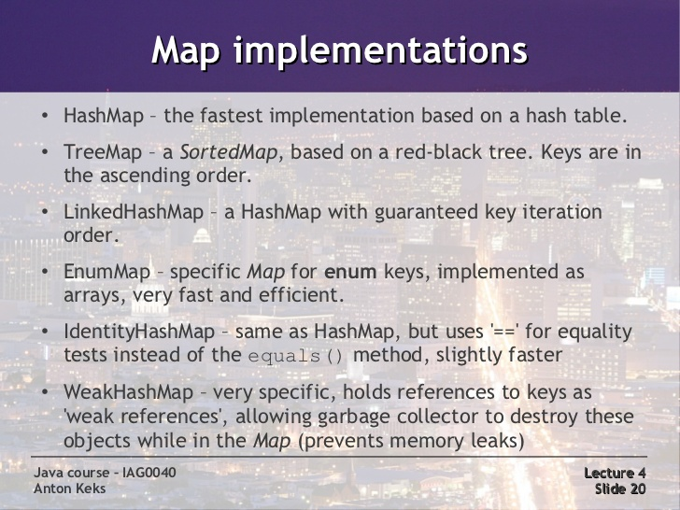
exceptions
Lab15.8: Demonstration of working with Maps with Anagram example:

Slide 39
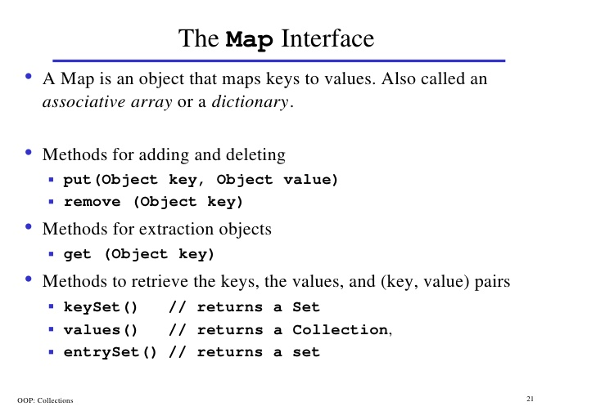
inheritance

Slide 40
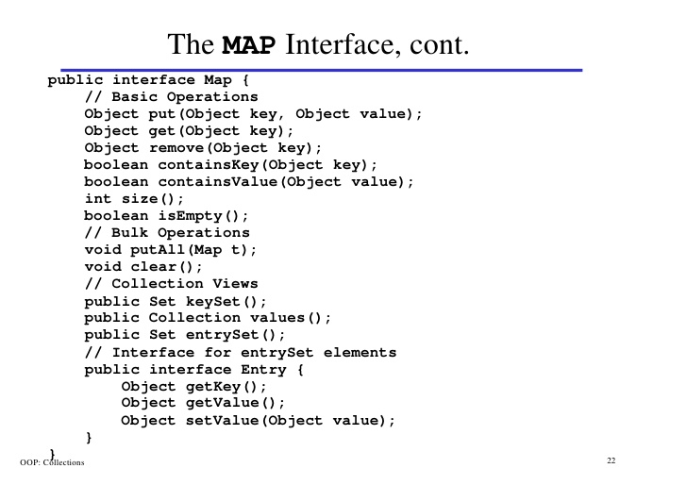
inheritance

Slide 41
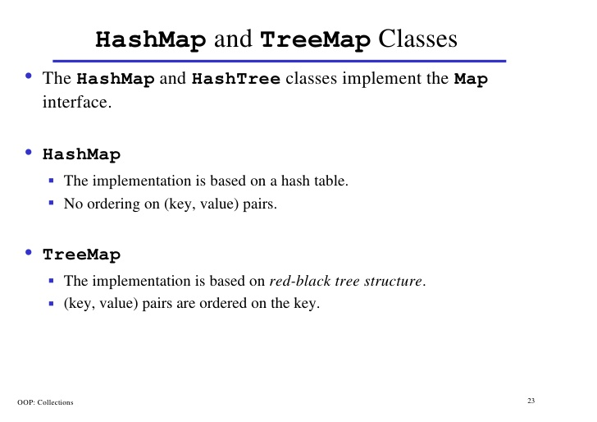
inheritance

Slide 42
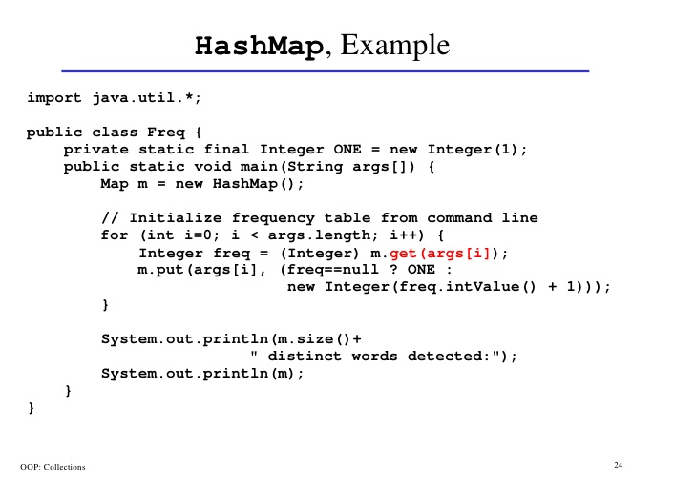
inheritance

Slide 43
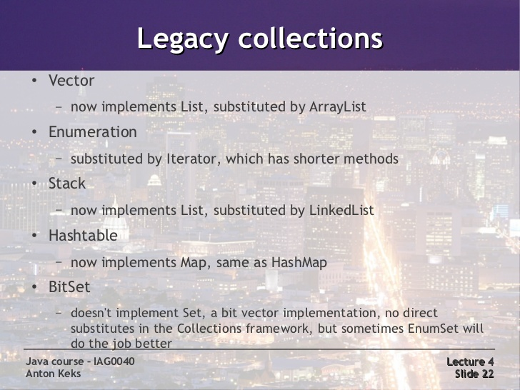
exceptions

Slide 44
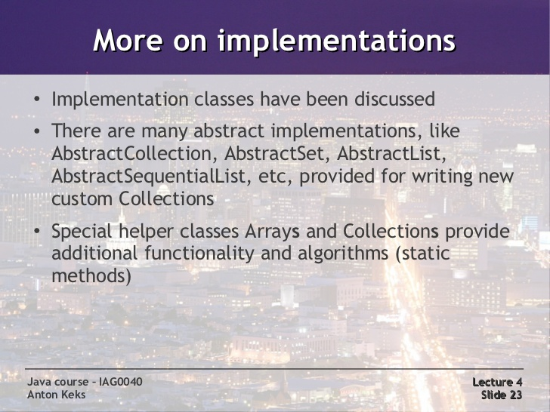
exceptions

Slide 45
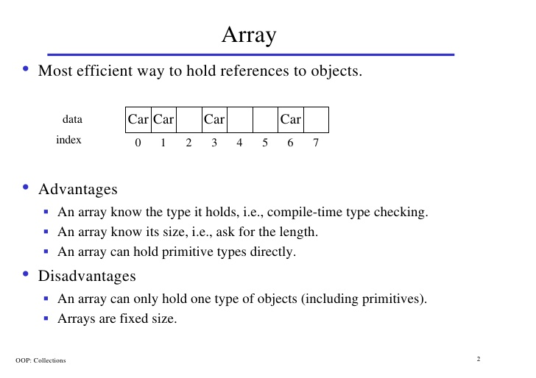
inheritance

Slide 46
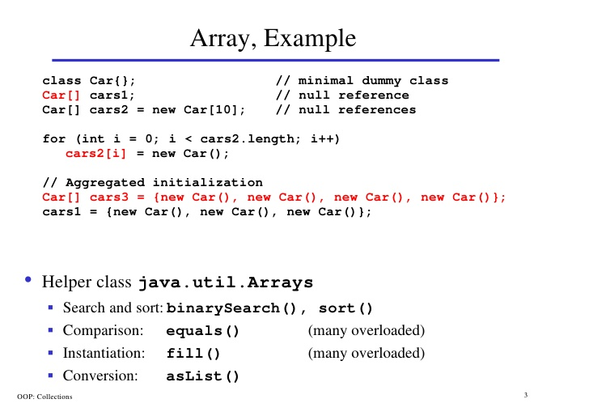
inheritance

Slide 47
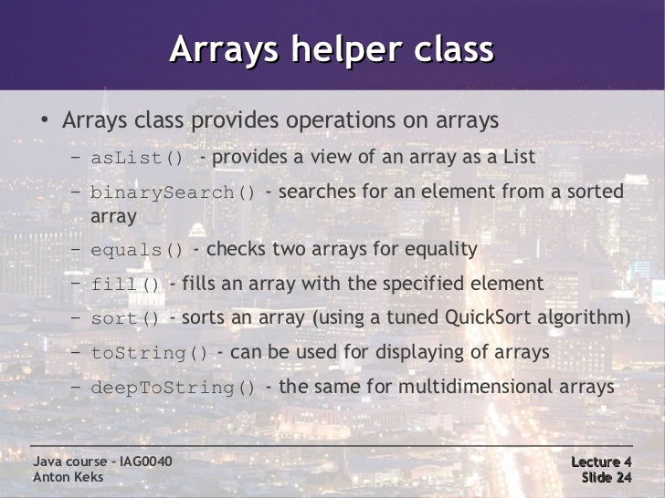
exceptions

Slide 48
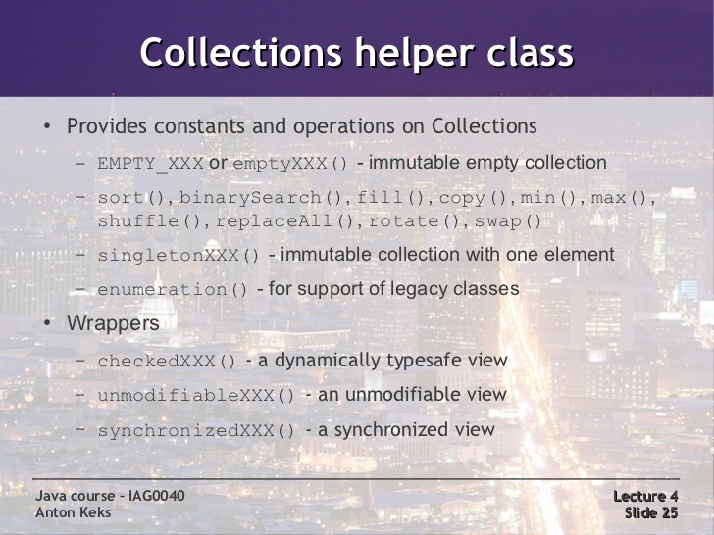
exceptions

Slide 49
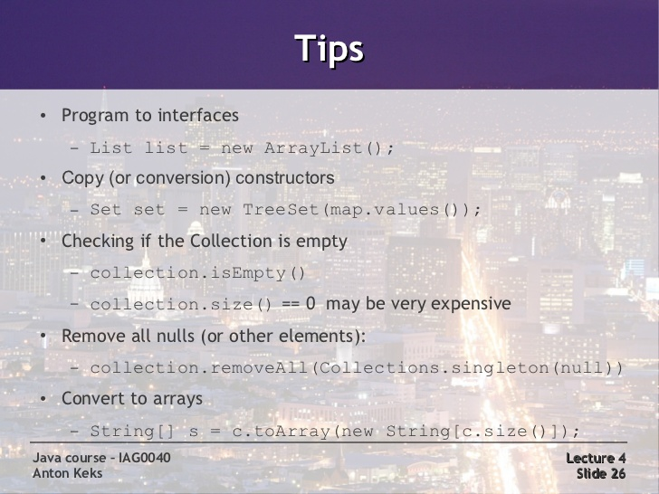
exceptions

Slide 50
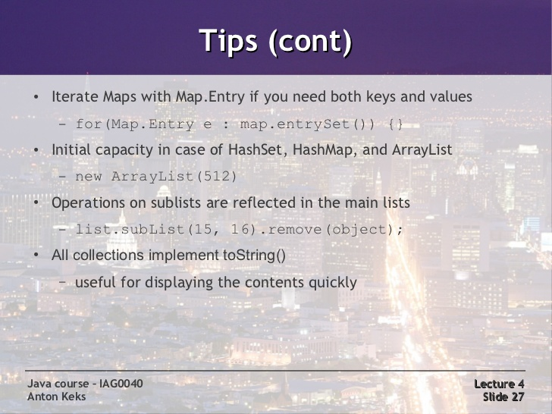
exceptions

Slide 51
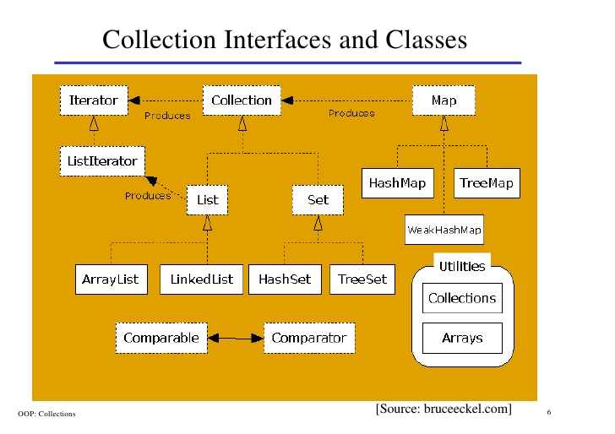
inheritance

Slide 52
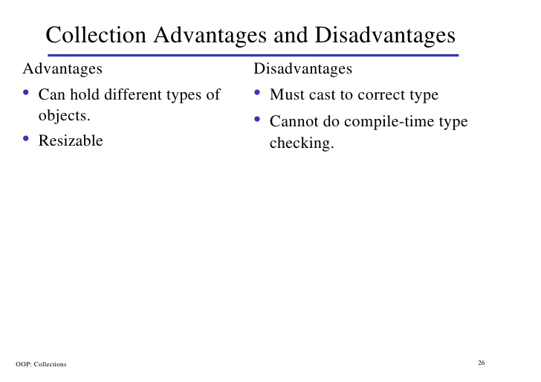
inheritance

Slide 53
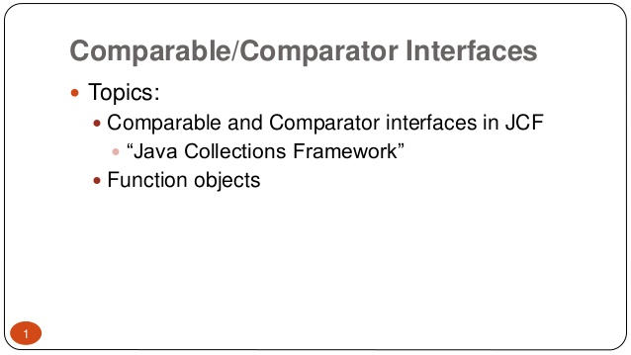
exceptions

Slide 54
exceptions

Slide 55

exceptions

Slide 56

exceptions

Slide 57

exceptions
Lab15.9: Demonstration of Comparing objects using Comparable interface:

Slide 58

exceptions

Slide 59

exceptions

Slide 60

exceptions

Slide 61

exceptions

Slide 62
exceptions

Slide 63

exceptions
Lab15.10: Demonstration of Comparing objects using Comparator:

Slide 64
exceptions

Slide 65
exceptions

Slide 66
exceptions

Slide 67
exceptions

Slide 68
exceptions

Slide 69
exceptions

Slide 70
exceptions

Slide 71
exceptions
Collections – A container is an object that groups multiple elemen its together in a single unit.
Used to store, retrieve, manipulate and communicate aggregate data.

Slide 72

inheritance

Slide 73
inheritance

Slide 74
inheritance

Slide 75
inheritance

Slide 76
inheritance

Slide 77
inheritance

Slide 78


inheritance

Slide 79
Interfaces and inheritance

Slide 80
Java - miscellaneous
Type Comparison Operator instanceof
The instanceof operator compares an object to a specified type.
You can use it to test if an object is an instance of a class, an instance of a subclass, or an instance of a class that implements a particular interface
Classes implementing interfaces
class MyClass extends MySuperClass implements YourInterface {
// field, constructor, and
// method declarations
}

Slide 81
Java - miscellaneous
Varargs – Specifying Arbitrary number of arguments
public Polygon polygonFrom(Point... corners) {
int numberOfSides = corners.length;
double squareOfSide1, lengthOfSide1;
squareOfSide1 = (corners[1].x - corners[0].x)
* (corners[1].x - corners[0].x)
+ (corners[1].y - corners[0].y)
* (corners[1].y - corners[0].y);
lengthOfSide1 = Math.sqrt(squareOfSide1);
// more method body code follows that creates and returns a
// polygon connecting the Points
}
You will most commonly see varargs with the printing methods; for example, this printf method:
public PrintStream printf(String format, Object... args)
allows you to print an arbitrary number of objects. It can be called like this:
System.out.printf("%s: %d, %s%n", name, idnum, address);

Slide 82

Java - miscellaneous
Returning a Class or Interface
When a method uses a class name as its return type the class of the type of the returned object must be either a subclass of, or the exact class of, the return type.
public Number returnANumber() {
...
}
The returnANumber method can return an ImaginaryNumber but not an Object. ImaginaryNumber is a Number because it's a subclass of Number. However, an Object is not necessarily a Number — it could be a String or another type

Slide 83
Advanced java
Garbage collection
JDBC
Lambda expressions
Annotations
Aggregate operations on collection using Lambarda expression.
Java streaming
Blocking queue
Aggregate operations

Slide 84
https://docs.oracle.com/javase/tutorial/reallybigindex.html
http://www.slideshare.net/EdurekaIN/java-class-3
http://www.slideshare.net/abdurrehmanabdurrehman391/variables-and-data-types-by-sir-khalid
http://www.slideshare.net/abdurrehmanabdurrehman391/java-advancedoop
http://www.slideshare.net/MindfireSolutions/java-garbage-collection-how-it-works?next_slideshow=1
http://www.slideshare.net/arnold7490/unit-4-java
http://www.slideshare.net/arnold7490/unit-3-java?next_slideshow=1
http://www.slideshare.net/tushardesarda/java-tutorial-3
http://www.slideshare.net/muralidhar9e/java-exception-handling-ppt
http://www.slideshare.net/emprovise/2-javabasics
http://www.slideshare.net/AllanHuang/java-new-evolution
http://www.slideshare.net/antonkeks/4-collections
http://www.slideshare.net/andreaiacono/java8-39841939 - Java8 features
http://www.slideshare.net/AbhishekKhune/07-java-collection
http://www.slideshare.net/shahjahan786/generics-27960064 - Generics

